Slide 1


Exploratory Data Analysis on Facebook Data
Tool: Python
Compiler: Jupyter Notebook
E. D. Analysis by:
Prashant Verma

Slide 2
Agenda & Area of Analysis
Agenda of Analysis:
Objective
Data Description
Data Analysis
Info & Insights from the Analysis
Area of Analysis:
Date of Birth (Age) Analysis
Friend-Count Analysis
Tenure Analysis
Like Analysis

Slide 3
Objective:
Data Preparation: Dividing Data into factors which are moulding User’s Behaviour based upon their Age, Tenure, Gender.
Visualization: Creating artefact about Assumption and Hypothesis for analysis of User’s behaviour.
Univariate and Bi-variate feature analysis upon data features.
Other variable observation
Faulty Users.

Slide 4
Data Description:
Input Main-Variables:
Age
Date of Birth
Gender
Tenure
Total Friend Count
Initiated Friendship Request Count
Total Number of Likes Send
Total Number of Likes Received
Input Sub-Variables:
Total Number of Likes Send by Mobile (Facebook App)
Total Number of Likes Received on Mobile (Facebook App)
Total Number of Likes Send by Desktop (Facebook Website)
Total Number of Likes Received on Desktop (Facebook Website)
Output Variables:
Facebook Popularity Visualization as per User’s Age.
Facebook Popularity Visualization as per User’s Gender.
Facebook Popularity Visualization as per Tenure of Users.

Slide 5
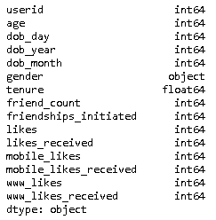
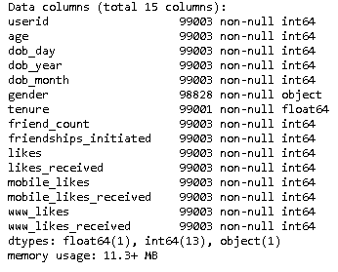
Data Description:
Details of Data Type
Initial Data Frame Info

Slide 6
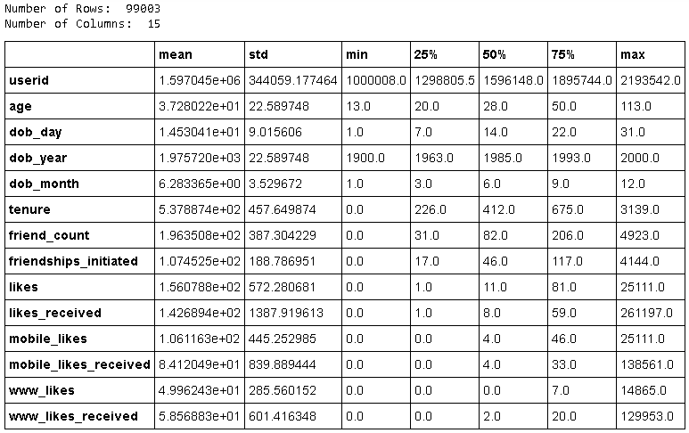
Data Description:
Statistics of Numerical Columns in Initial (RAW) Facebook Dummy Data Frame

Slide 7
Data Analysis:
Data Preparation
Cleaning of empty columns in dataset.
Handling OUTLIERS from each feature columns.
Creations of New Columns as per Analysis requirements names “Age_Group” and “Tenure_Year” as listed below,
Column Name: Age_Group
infant (birth-12 months)
toddler (1-4 years)
child (5-11 years)
preteen (12 years)
teenager (13-19 years)
youngster (20-25 years)
adolescents (26-30 years)
adult (31-40 years)
mid-aged (41-60 years)
senior citizen (60+ years)
Column Name: Tenure_Year
tenure <= 365: return '1 year'
365 < tenure <= 730 : return '2 year'
730 < tenure <= 1095 : return '3 years'
1095 < tenure <= 1460 : return '4 years'
1460 < tenure <= 1825 : return '5 years'
1825 < tenure <= 2190 : return '6 years'
2190 < tenure <= 2555 : return '7 years'
tenure > 2555: return '8+ years'

Slide 8
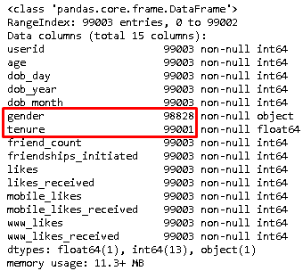
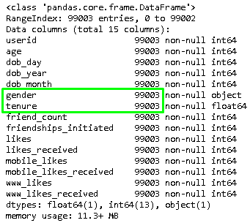
Data Analysis:
Data Preparation – Handling Null Values
Need to fill-out the NULL values in Gender (175 cells) and Tenure (2 cells) columns.
Changing Gender Null Value data with MODE value of column.
Changing Tenure Null value data with MEAN value of column.
Initial Data Frame Info
Modified Data Frame Info

Slide 9
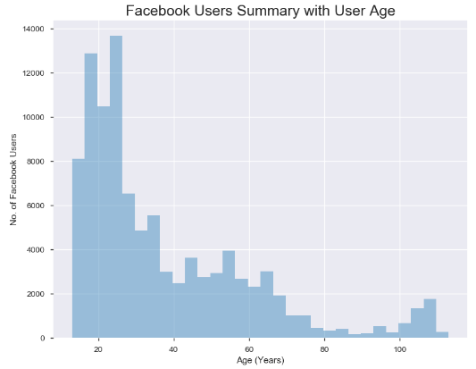
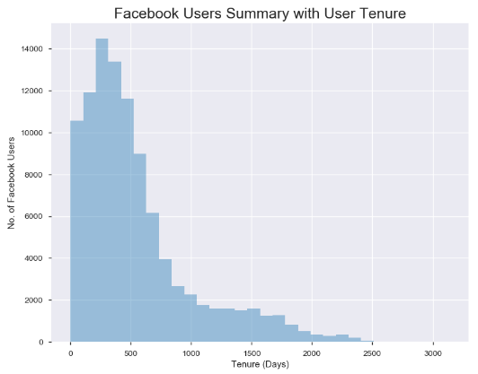
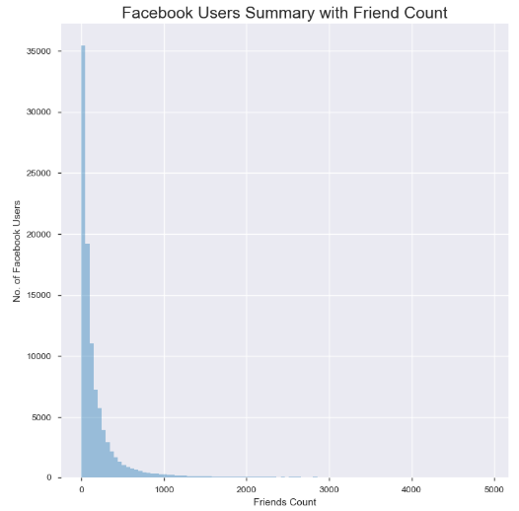
Data Analysis:
Data Preparation – Cleaning Outliers
Need to find-out OUTLIERS in Age, Tenure, Friend-Count columns.
Users with Age > 100 years seems an Outliers in “Age” Column.
Users with Tenure > 2000 days seems Outliers in “Tenure” Column.
Users with Friend Count > 1000 seems Outlier in “Friend_Count” Column.

Slide 10
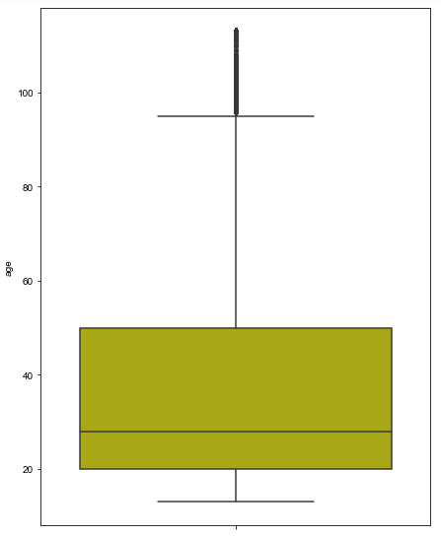
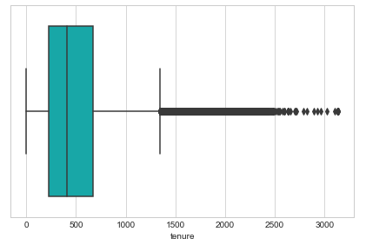
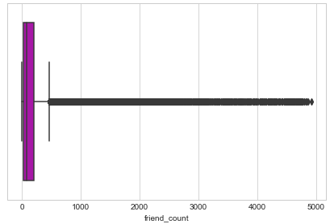
Data Analysis:
Data Preparation – Cleaning Outliers
Identifying OUTLIERS in Age, Tenure, Friend-Count columns from Box Plot representations,
Outlier from “Age” Column comes around 95 yrs.
Outlier from “Tenure” Column comes around 1400 days.
Outlier from “Friend_Count” Column comes around 500 users.

Slide 11
Data Analysis:
Data Preparation – Adding New Columns
Addition of new columns for further analysis,
Total_Likes_Send and Total_Likes_Received for Likes analysis.
Age_Group for categorization age column data in to age groups.
Tenure_Year for categorization of tenure column data in to year groups.
Total Likes Send = [Total Mobile Likes] + [Total Desktop Likes]
Total Likes Received = [Total Mobile Likes Received] + [Total Desktop Likes Received]
Age Group Categorization:
# Child(5-12 years)
# Teenager (13-19 years)
# Youngster (20-25 years)
# Adolescents (26-30 years)
# Adult (31-40 years)
# Mid-aged (41-60 years)
# Senior citizen (60+ years)
Tenure Year Categorization:
# 1 year (tenure <= 365 days)
# 2 years (365 days < tenure <= 730 days)
# 3 years (730 days < tenure <= 1095 days)
# 4 years (1095 days < tenure <= 1460 days)
# 5 years (1460 days < tenure <= 1825 days)
# 6 years (1825 days < tenure <= 2190 days)
# 7 years (2190 days < tenure <= 2555 days)
# 8+ years (tenure > 2555 days)

Slide 12
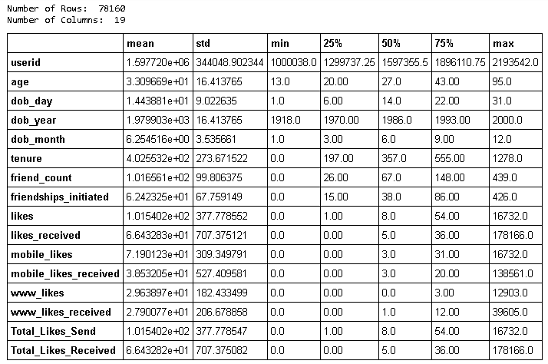
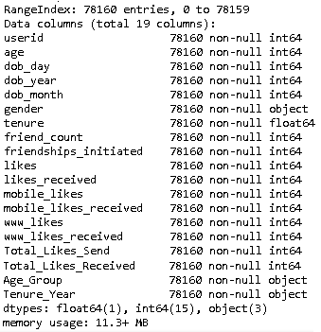
Data Analysis:
Statistics of Numerical Columns in Refined Final Facebook Dummy Data Frame
Final Modified Data Frame Info

Slide 13
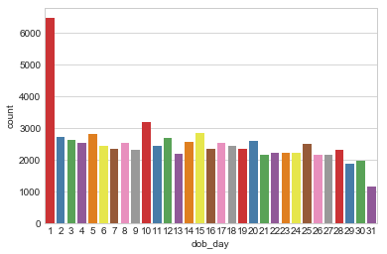
Data Analysis: DoB (Age)
Data Visualization: Date Analysis
Observation:
Majority of FB Users have their Birth Date as 1'st date of month which implies that either it is not being altered by the user or it's an actual date of all users.

Slide 14
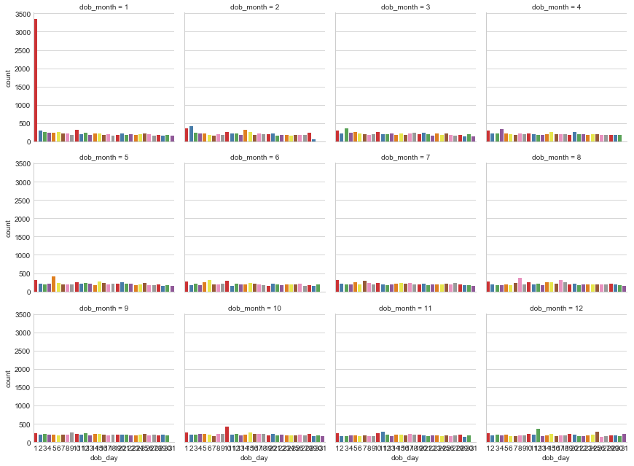
Data Analysis: DoB (Age)
Data Visualization: Month Analysis
Observation: Above graph shows that majority of FB Users have their Birth Date as 1'st date of January month which implies that it is not being altered by the user or they have selected default date as their DoB.

Slide 15
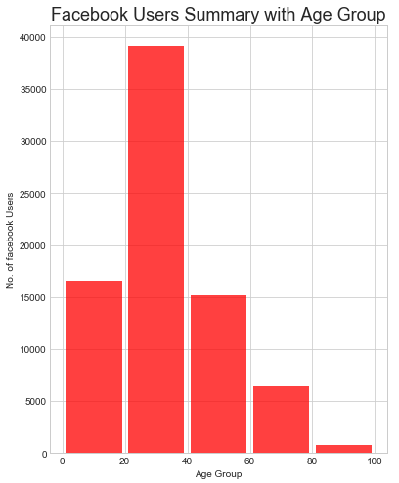
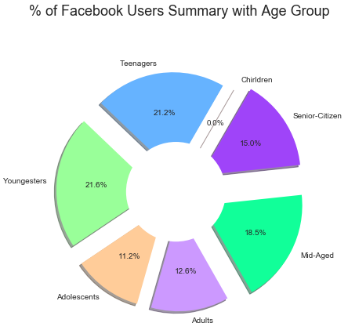
Data Analysis: DoB (Age)
Data Visualization: Participation of Users as per Age Group
Observation:
These graphs show that majority of Facebook Users are form 20-40 yrs age range. While checking Age Group category % data, top users belongs to Youngsters (20-25 age) group with 21.6% of total, followed by Teenagers (13-19 age) group with 21.2% of total and then Mid-Aged (41-60 age) group with 18.5% of total.
However, Adolescents (26-30 age) and Adults (31-40 age) are using Facebook with almost equal ratio as 11.2% and 12.6% respectively.

Slide 16
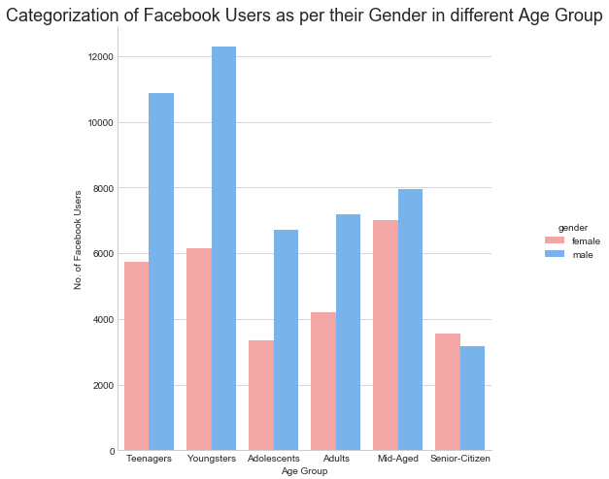
Data Analysis: DoB (Age)
Data Visualization: Participation of Users as per Gender
Observation:
This graph shows that majority of Facebook Users are Males with respect to Females in all age group users. Though, this trend defied by Females as major Facebook Users in comparison of Males for Senior-Citizen (60-100 age) age group.

Slide 17
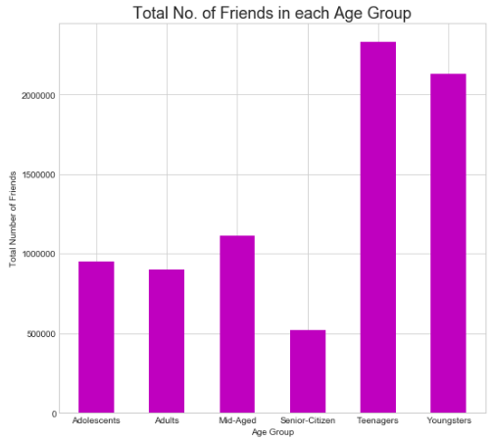
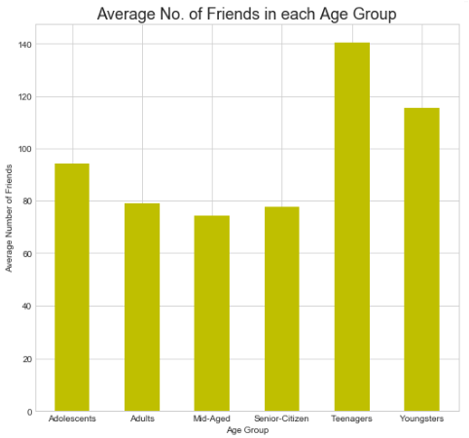
Data Analysis: Friend Count
Data Visualization: Total and Avg. Number of Friends as per Age Group
Observation:
These graph shows that Teenagers toped in Total No. of Friends Counts, among other Age groups of Facebook Users, followed by Youngsters and then Mid-aged. Though, this trend keeps following in same way in Average No. of Friends Counts ranked on top by Teenagers among other age-groups, followed by Youngsters and then Adolescent.

Slide 18
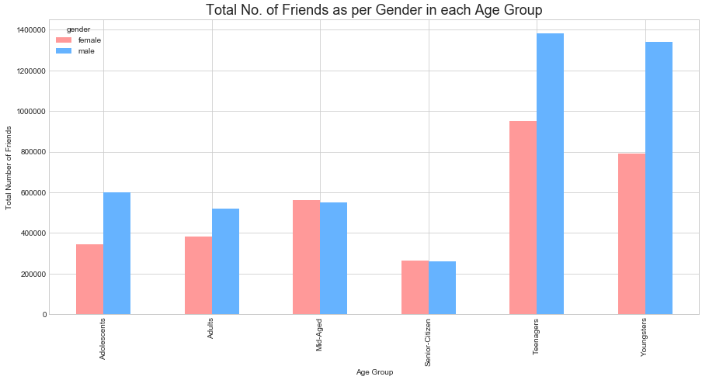
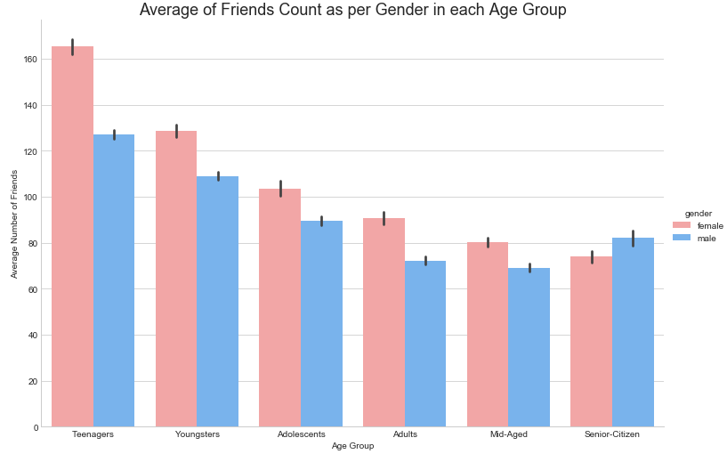
Data Analysis: Friend Count
Data Visualization: Total & Avg. Number of Friend Counts as per Gender from each Age Group
Observation:
First graph shows that Males from all groups, have more Total Number of Friends as comparison to Females except in Mid-Aged and Senior Citizen age group. Second graph shows that Females have more Average Number of Friends than Male counterparts in all Age Groups except in Senior-Citizen group.

Slide 19
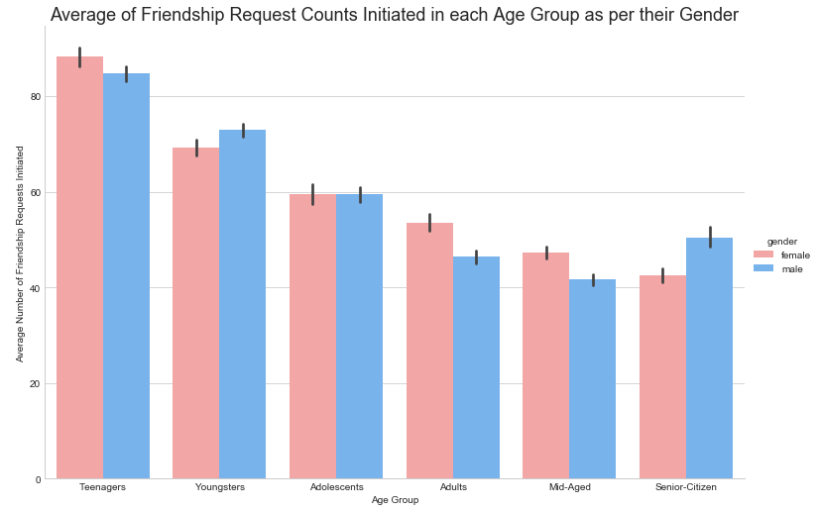
Data Analysis: Friend Count
Data Visualization: Avg. Number of Friend Request Initiated as per Gender from each Age Group
Observation:
This graph shows that Females from Teenagers, Adults and Mid-Aged groups, leads with Males in initiating the Facebook Friend Requests. Though, Male from Youngsters, Adolescents and Senior-Citizen are also leading with Females in initiating the Facebook Friend Requests.

Slide 20
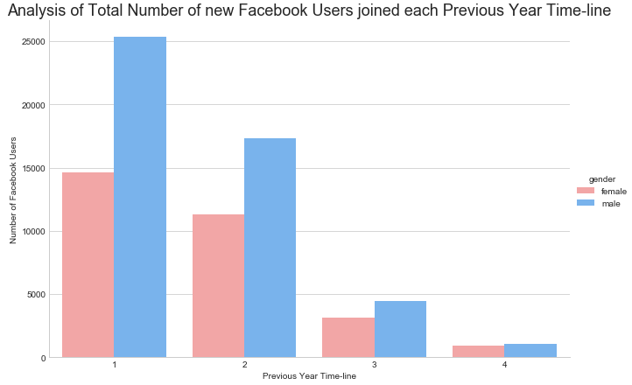
Data Analysis: Tenure
Data Visualization: Newly joined FB Users in each Previous Year Timelineas per Gender
Observation:
The graph shows that Males were more active than Females who joined Facebook in previous years of timeline.

Slide 21
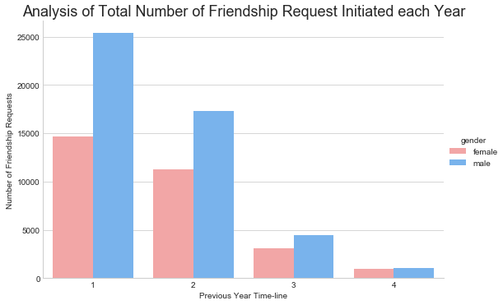
Data Analysis: Tenure
Data Visualization: Newly FB Friend Request Initiated in each Previous Year Timeline as per Gender
Observation:
The graph shows that Males were more active in initiating Facebook Friend Request than Females in previous years of timeline.

Slide 22
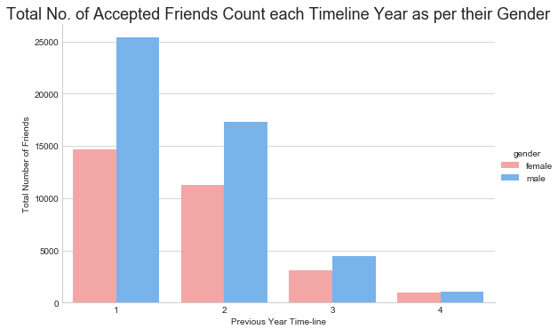
Data Analysis: Tenure
Data Visualization: New FB Friend Requested Accepted in each Previous Year Timeline as per Gender
Observation:
This graph shows that Males were more active than Females who accepted Friendship Request in previous years of timeline.

Slide 23
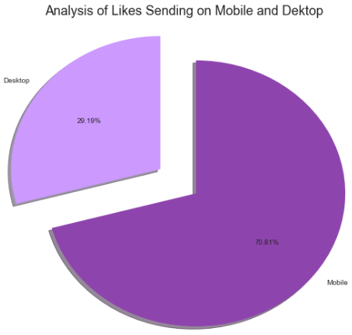
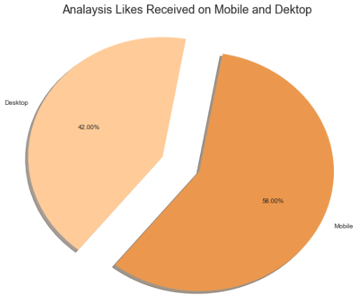
Data Analysis: Like
Data Visualization: Total Number of Likes Send and Received on Mobile and Desktop.
Observation:
First graphs shows that almost 2/3'rd of FB Users use Mobile app for Sending Likes to other users. Second graph shows that both Mobile & Desktop Users Received Likes in almost same 50-50 ratio.

Slide 24
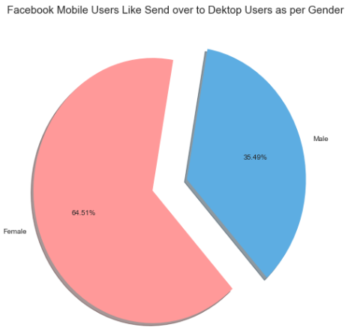
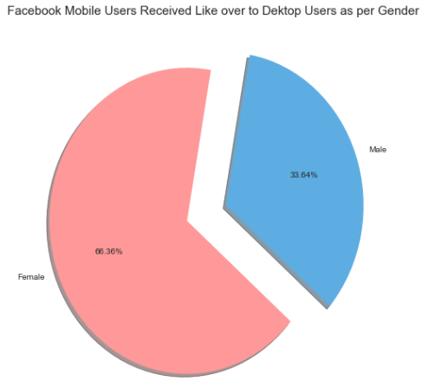
Data Analysis: Like
Data Visualization: Total Number of Likes Send and Received as per Gender
Observation:
Both graph shows that almost 2/3'rd of Mobile Users are Female and who are more active in Sending Likes and Receiving Likes as comparison of Desktop Users.

Slide 25
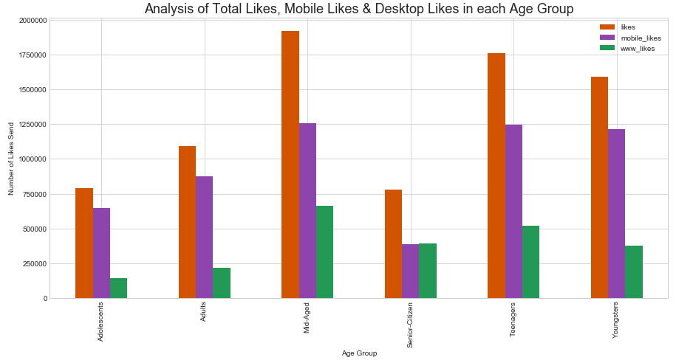
Data Analysis: Like
Data Visualization: Total Likes Send from Mobile and Desktop as per Age Group
Observation:
This graph shows that Mobile version of Facebook is more popular for Sending Likes among all user's Age Group, topped by Mid-Aged Users followed by Teenagers and then Youngster.

Slide 26
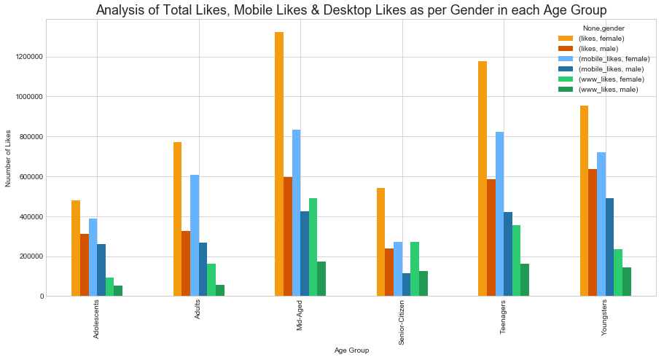
Data Analysis: Like
Data Visualization: Total Likes Send from Mobile and Desktop as per Gender in each Age Group
Observation:
This graph shows that Female Mobile Users are more active in Liking posts in FB than Males, topped by Mid-Aged Females followed by Teenagers and then Youngster.

Slide 27
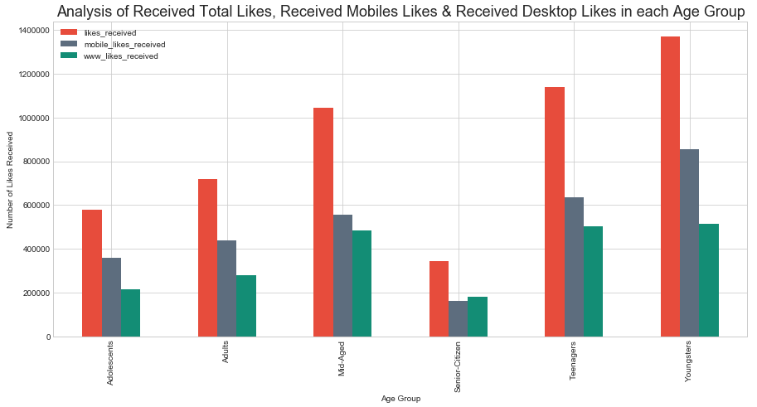
Data Analysis: Like
Data Visualization: Total Received Likes on Mobile and Desktop as per Age Group
Observation:
The graph shows that all the Age Group Received Likes more in Mobile version of Facebook, topped by Youngsters followed by Teenagers and Mid-Aged Users with an exception in Senior Citizen group.

Slide 28
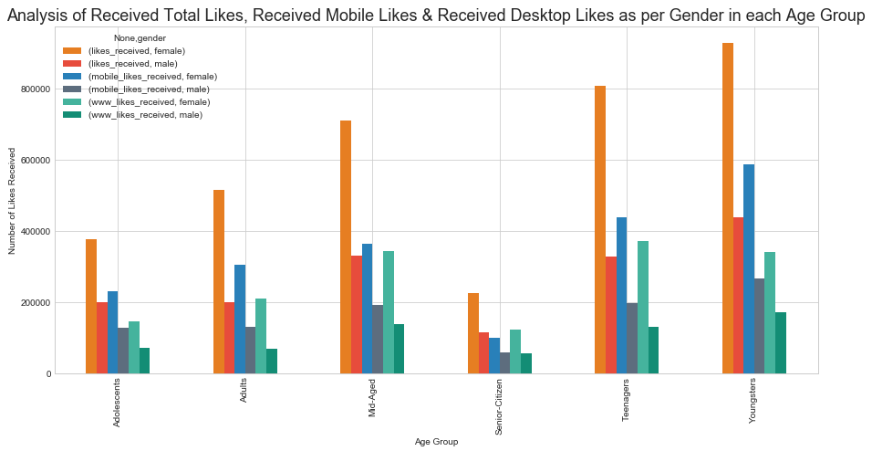
Data Analysis: Like
Data Visualization: Total Received Likes on Mobile and Desktop as per Gender in each Age Group
Observation:
The graph shows that Female Mobile Users Received more Likes than Males in all Age Groups, topped by Youngster Females followed by Teenagers and then Mid-Aged.

Slide 29
Data Analysis: Like
Comparison between Send & Received Likes

Slide 30
Data Analysis: Like
Comparison between Send & Received Likes as per Gender

